Slide 1

Modeling Value at Risk (VaR): Monte Carlo Simulation
Randomized Algorithm for Tail Risk Estimation
Milestone – 4
Section 1
Group – 4
CSE 400 : Fundamentals of Probability in Computing
Prepared By : Masoom Choksi (AU2440263)
Jinay Shah (AU2440296)

Slide 2
Project Context and Motivation
Monte Carlo Simulation- Randomized Algorithm Domain: Financial Risk Management
Why this matters:
Financial markets shift quickly and change often.
Standard models suppose stable results.
Actual risk calls for including possible outcomes.
These methods are used by banks and financial supervisors under Basel III.
Goal:
Examine fixed vs random (Monte Carlo) value-at-risk approaches.
2

Slide 3
Project Objective and Deterministic Baseline
•
Objective
Figure out VaR at 95% confidenceVaR shows the biggest possible loss under normal market conditions
•
Deterministic Baseline Strategy
VaR equals average loss plus Z times standard deviation of lossZ is 1. 645 for 95% confidence.
This assumes losses follow a normal distribution
• Portfolio: Five stocks, AAPL, MSFT, NVDA, GOOG, AMD each has a weight of 0. 30, 0. 25, 0.20, 0. 15, and 0. 10 respectively
• Result:Deterministic VaR comes to 0.0243%.
3

Slide 4
Baseline System Pipeline Overview
•
End-to-End Implementation
Historical Returns
↓
Estimate Parameters (μ, 𝛔)
↓
Generate Random Returns
↓
Convert to losses
↓
Compute VaR(Percentile)
↓
Backtesting
4

Slide 5
Baseline System Pipeline Overview
•Where Uncertainty Enters
Generating returns with random seeds probably leads to different outcomes each time.
Each simulation runs on a unique seed, so results may shift slightly between sessions.
The normal distribution might not fit actual market patterns well - Mostly during volatility spikes.
Market movement in the future remains largely unknown and cannot be forecasted reliably.
With only 10,000 simulations, the outcome depends on a small, limited sample size.
Our Approach:
Using randomization helps avoid false confidence in predictable results. We accept that outcomes are not fixed and vary naturally over time. Now, but we use varied seeds to reflect real-world unpredictability more accurately.
5

Slide 6

Source of Uncertainty in VaR Simulation
1.Parameter Uncertainty:
We compute average return using 400 days of data.
Thats just one set of numbers - the real average might differ.
Formula : our result includes a margin of error.
2. Distribution Uncertainty (Fat Tails):
Normal math says a 5% loss occurs once every 1,000 years.
In reality, we’ve seen several crashes above 5% in the past ten years.
Markets show fat tails - big drops happen more frequently than expected.
3.Sampling Uncertainty(Fat Tails):
Doing 10,000 runs produces slightly different VaR values each time.
Increasing the number of simulations leads to a more consistent result.
4.Model Uncetainty:
Our picks, XLK, MTUM, VLUE, may not include all possible risks.
The idea that prices move in straight lines could be incorrect.
How randomization handles this: We test every possible outcome instead of sticking to a single prediction.
6

Slide 7



DATA PREPARATION & PORTFOLIO CONSTRUCTION
Random Variables in our Model
Variable | Distribution
Portfolio Returns(R)
Loss(L)
Simulated Returns
• Assumptions:
Assumption 1 - Law of large Numbers :When we run 10,000 simulations, the results match the real distribution. This is like asking 10,000 people instead of 100, outcomes become consistent and accurate.
Assumption 2 - Bootstrap Principle : Historical losses predict future losses. We pick randomly from past losses, replacing items as needed. This gives a close match without using math formulas.
Assumption 3 - Extreme Value Theory (EVT) : Uncommon events follow different patterns than regular ones. An exponential model fits well for worst-case scenarios.It steps in when normal patterns break down.
Assumption 4 - Normal Distribution (for most days) : A normal curve works well for 95% of daily results. It fails during the remaining 5% of extreme days.
7

Slide 8


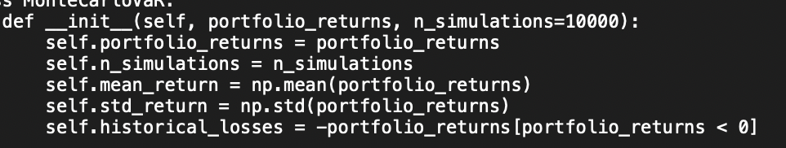
Probabilistic Modeling with Deterministic Decisions
Our Approach - Hybrid Model:
We create 10,000 random return scenarios.
We apply a fixed decision rule: VaR equals the percentile of losses.
Mathematical Formulation:
Simulated Returns: for i = 1 to 10,000
Simulated Losses: for <0
VaR Estimate: = 95th percentile of
Code Implementation:
Why it Works:
Randomness reflects real-world return uncertainty. The rule ensures every analysis stays consistent. Combined, they produce reliable risk estimates.This model handles variation without distortion. It maintains clarity in every outcome.
8

Slide 9
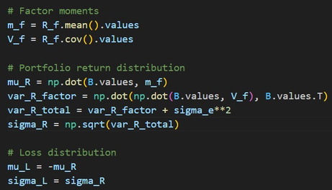
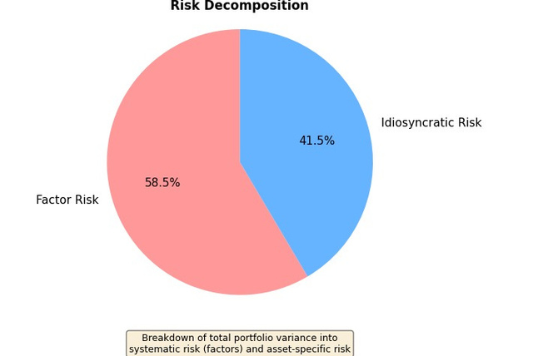
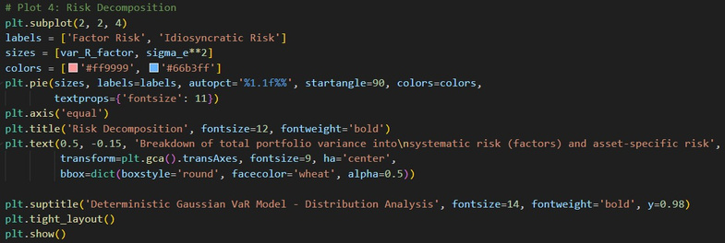
VARIANCE DECOMPOSITION & RISK ANALYSIS
Code Snippet
Output
9

Slide 10
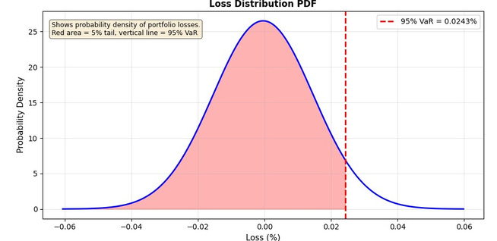
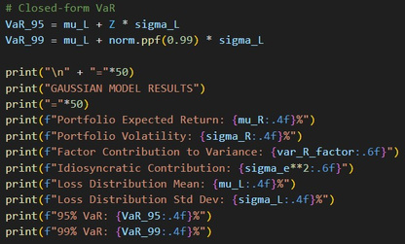
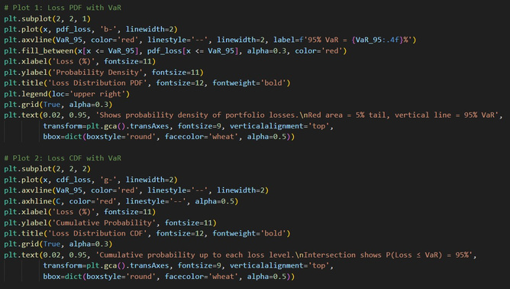
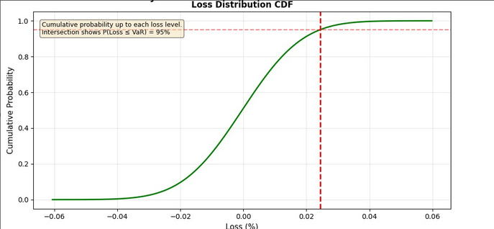
LOSS DISTRIBUTION & VAR CALCULATION
Graph-Simulation
Code Snippet
10

Slide 11
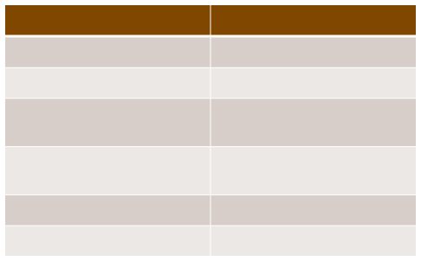
LOSS DISTRIBUTION & VAR CALCULATION
Metric
Expected Return (µ_R) Portfolio Volatility (σ_R)
Daily Value
0.0004% 0.0151%
Loss Distribution Mean (µ_L)
-0.0004%
Loss Distribution Std Dev
0.0151%
(σ_L)
95% VaR
99% VaR
0.0243%
0.0346%
11

Slide 12
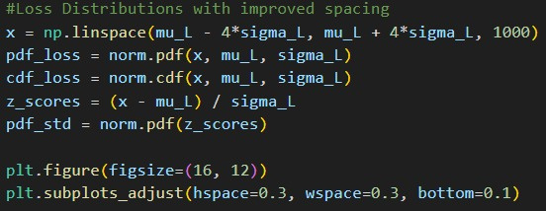
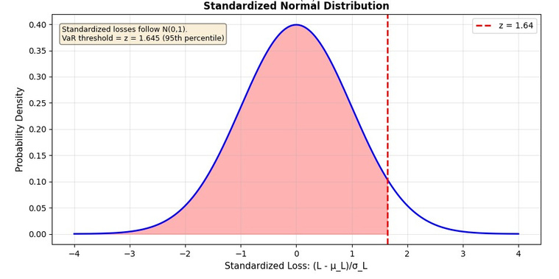
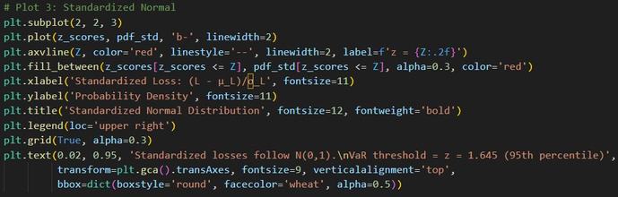
STANDARDIZED NORMAL DISTRIBUTION
Code Snippet
Graph-Simulation
12

Slide 13



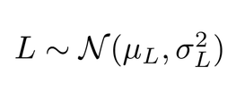

Deterministic Baseline Logic
• •
•
Factor loadings β, Factorcovariance Σf
,Idiosyncraticvariance
and VaRthreshold are fixed.
No re-estimation, no adaptive updating, and no stochastic optimization.
Analytical Structure:
➢ ➢ ➢
➢
Factor Model: Portfolio Variance :
Loss distribution(Gaussian Assumption):
Closed-Form VaR:
•
Interpretation
This VaR is a static probabilistic benchmark. It provides:
➢Analytical clarity
➢Computational efficiency
➢A fixed risk threshold for evaluation
13

Slide 14
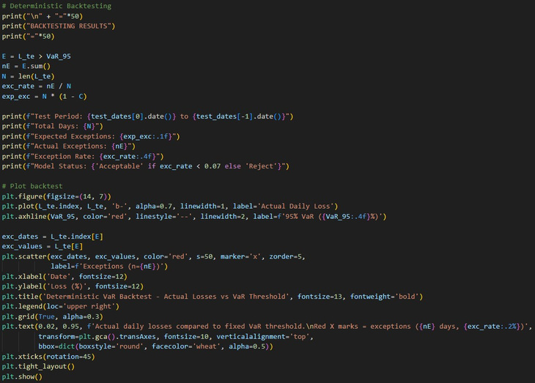
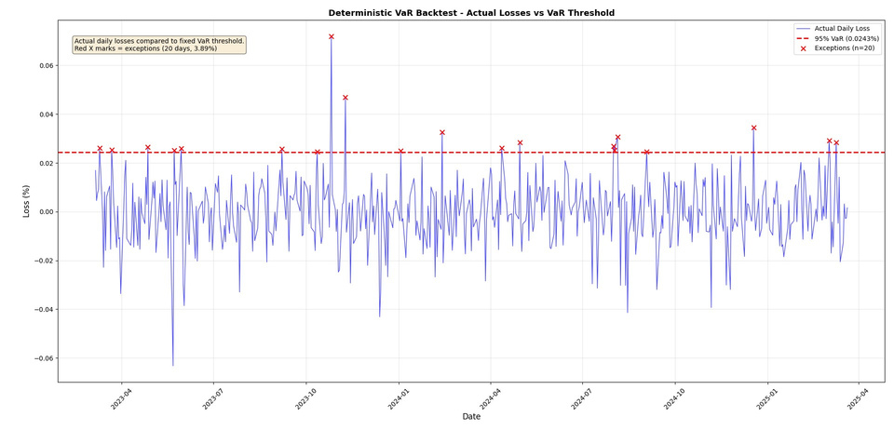
BACKTESTING RESULTS
Code Snippet
Graph-Simulation
14

Slide 15
Performance Analysis of Deterministic Baseline
•
Strengths
➢ ➢ ➢ ➢
Stableacross the test period
Slightly conservative risk estimates Computationally efficient Fully interpretable framework
•
Limitations
➢ ➢
AssumeGaussian tail risk Static parameters (no dynamic updating)
15

Slide 16
Summary and Transition
•What Milestone 3 achieved
➢ ➢ ➢ ➢
Fullend–to–endsimulation Deterministic VaR baseline Analytical implementation Out- of- Sample validation
•Why randomized Strategies Next?
➢ ➢ ➢ ➢
Improved tail riskmodelling Stress scenario simulation Adaptive risk thresholds Monte Carlo flexibility
16

